Slide 1
YOUTH AND FAITH: ENGAGING THE NEXT GENERATION WITH LEGION OF MARY
By
Aloysius Kiribaki,
President Senatus of Uganda

Slide 2
Presentation outline
In this presentation, we will look at the following:
Meaning of the key terms – Youth and Faith
What Legion of Mary is and what its role is in the Church’s mission of Evangelisation
How do we Engage the Next Generation with Legion of Mary?
Conclusion

Slide 3
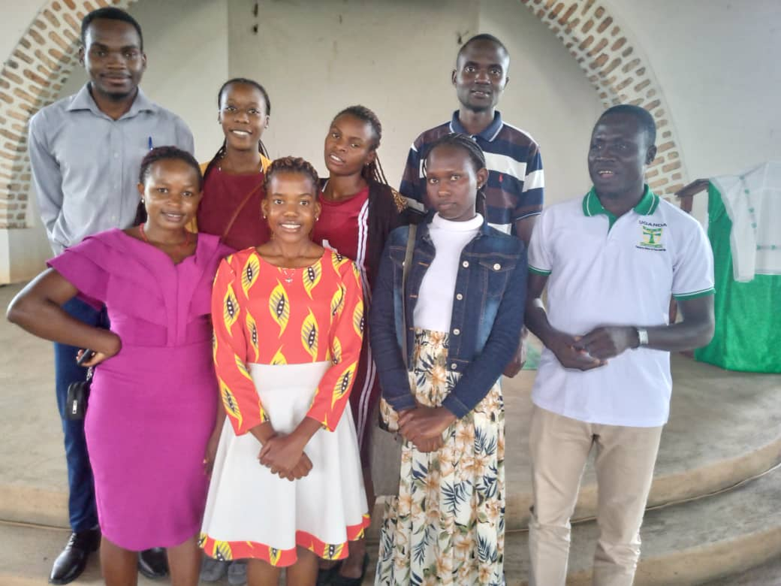
Meaning of the term Youth
Age group between childhood and adulthood, typically spanning from adolescence (around 13-19 years old) to early adulthood (up to the mid-30s)

Slide 4
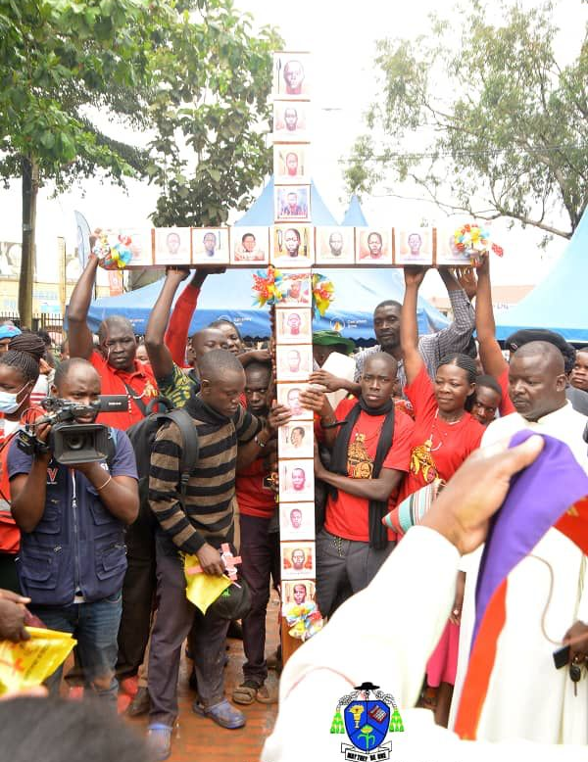
Meaning of the term Faith
Faith refers to a strong belief and trust in God, Jesus Christ, and the teachings of the Church.

Slide 5
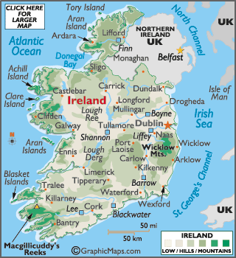
What is Legion of Mary and what is its role in the Church’s mission of Evangelisation?
The Legion of Mary is a Catholic lay apostolic organization founded by Frank Duff in Dublin, Ireland, on September 7th, 1921. Its primary purpose is to promote the spiritual growth of its members and engage in various forms of apostolic work within the Catholic Church.

Slide 6
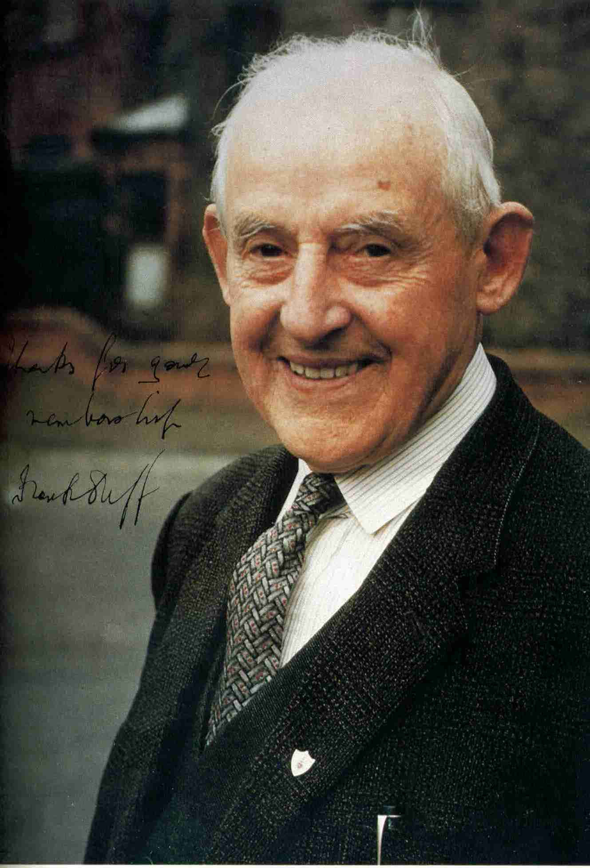
What is Legion of Mary and what is its role in the Church’s mission of Evangelisation?
The main objects of the Legion of Mary are:
a) The Glory of God
b) The Sanctification of Its Members
c) The Spiritual and Apostolic Renewal of the World
Servant of God, Frank Duff Founder of the Legion of Mary
June 7, 1889 – November 7, 1980

Slide 7
Organisational Structure
Legion of Mary has a central council called the Concilium legionis, governing the Legion around the world through subordinate national or regional councils called Senatus or regia; has diocesan or district councils called Comitia, parish councils called curiae, and local groups, each called a praesidium.
Concilium
Senatus
Regia
Comitium
Curia
Senior Praesidium
Junior Praesidium

Slide 8
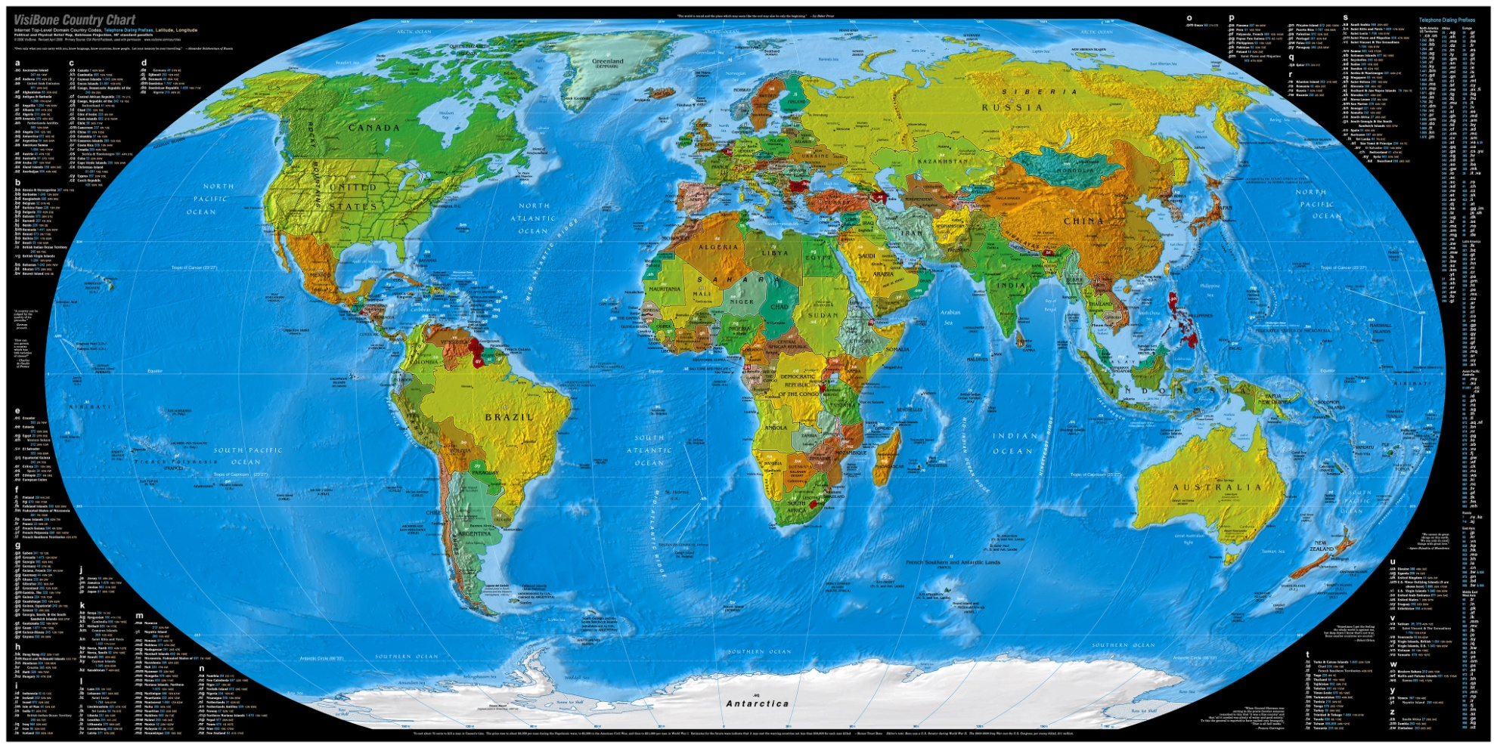
Expansion
In 1927, the Legion of Mary began to move into all the dioceses of Ireland;
In 1928, it crossed the seas and took root in Scotland.
Then, in 1929, England opened its gates to it.
In 1931, it entered America;

Slide 9
Expansion and Spread Worldwide
In 1932, Australia;
In 1933, Africa;
In 1937, Asia, through China;
In Uganda, the first Praesidium was established on 24th September 1938, in Nkokonjeru PTC.
In 1940, the Philippines;
In 1948, Japan.

Slide 10
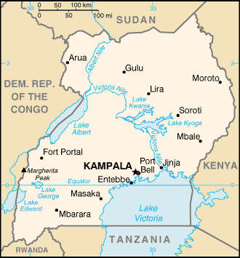
Global presence and Population
There are now over 15 million active and auxiliary members of the Legion in over 170 Countries globally.
The Legion of Mary is working in more than 900 Catholic dioceses, with an increase of about two per week.
We have over 600,000 members spread in all the 19 Catholic Dioceses of the Uganda. This year, and on 23rd September, 2023, we are going to celebrate 85 years of dedicated service of Legion of Mary in Uganda.

Slide 11
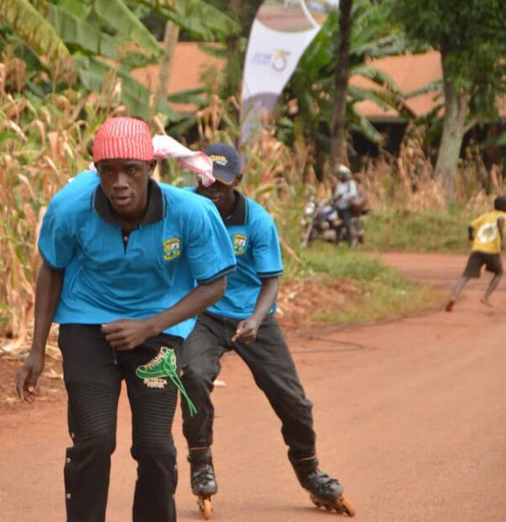
How can we Engage the Next Generation with Legion of Mary?
"Youth and Faith: Engaging the Next Generation with Legion of Mary" requires us holding discussions and developing strategies for involving young people in the activities and mission of the Catholic Church and that of Legion of Mary

Slide 12
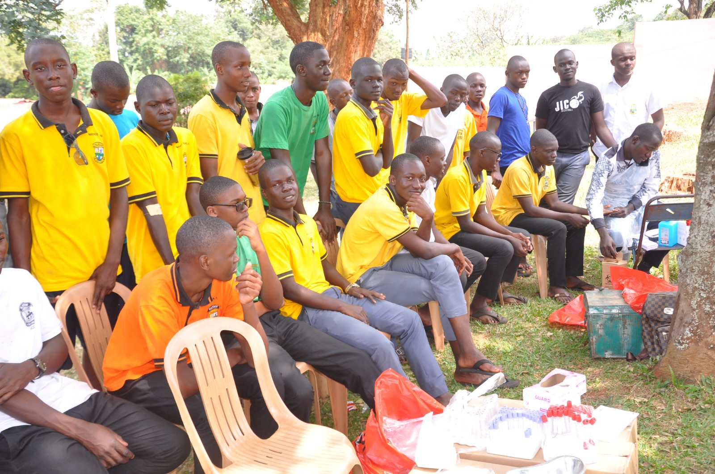
How can we Engage the Next Generation with Legion of Mary?
i) Fostering Intellectual Exploration through Youth Focused programs
Give them chance to challenge themselves intellectually. Socrates once said, "An unexamined life is not worth living."

Slide 13
How can we Engage the Next Generation with Legion of Mary?
ii) Digital Outreach:
We need to leverage the power of technology to reach the younger generation. Pope Francis, in his encyclical "Laudato Si'," stated, "Technology can be a wonderful tool, but it is not a substitute for personal engagement."

Slide 14
How can we Engage the Next Generation with Legion of Mary?
iii) Youth Leaders
Empower young people to take leadership roles within the Church. As 1 Corinthians 12:4-6 tells us, "There are different kinds of gifts, but the same Spirit distributes them. There are different kinds of service, but the same Lord. There are different kinds of working, but in all of them and in everyone, it is the same God at work."

Slide 15
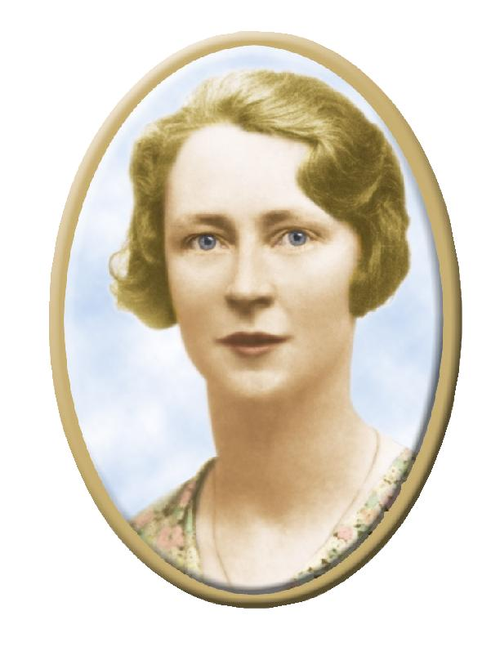
How can we Engage the Next Generation with Legion of Mary?
iv) Youth-Friendly Materials
Create age-appropriate faith materials and resources such as books, pamphlets etc.
v) Regular Youth Meetings
Organize regular youth meetings where members can discuss their faith, share personal experiences and seek guidance.
vi) Fostering a culture of missionary discipleship and Cultural Integration
Cultivate a sense of missionary zeal among the young people.

Slide 16
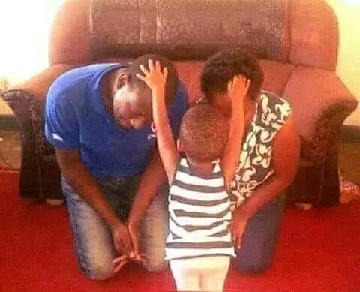
How can we Engage the Next Generation with Legion of Mary?
vii) Parental Involvement
Engage parents in the youth's faith journey.
viii) Prayer and Spiritual Development
Encourage a deep and personal relationship with God through prayer and meditation.
ix) Role Models
Provide positive role models within the church community.
x) Adaptation and Innovation
Stay open to new approaches and methods of evangelization

Slide 17
Pope Paul VI
Questions to ponder
How can the Catholic Church adapt its approach to better engage and connect with today's youth?
In what ways can technology and social media be leveraged to reach and engage young people in matters of faith and service?
How can the Catholic Church help young people navigate the complexities of their faith in a rapidly changing world?
“Mr. Duff, I want to thank you for your services to the Church and also to express appreciation for all that the Legion of Mary has done.”
“The Legion of Mary has served the Church faithfully, and the Church will protect the Legion.”
Notes:
The highlight of the trip was his private audience with Pope Paul VI on December 11th, 1965. The Holy Father said to him, (click) “Mr. Duff, I want to thank you for your services to the Church and also to express appreciation for all that the Legion of Mary has done.” When Br. Duff thanked the Holy Father and assured him of the Legion’s loyalty to the Pope and his priests and bishops “even to the point of martyrdom”, the Holy Father added, (click) “The Legion of Mary has served the Church faithfully, and the Church will protect the Legion.”

Slide 18
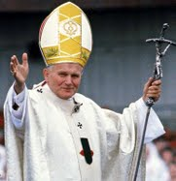
Conclusion
The future of faith lies in the hands of our youth and the Catholic Church offers a powerful avenue to engage and empower the next generation. By fostering a sense of community, service, and spirituality, we can ensure that our youth not only inherit our faith traditions but also become active contributors to a brighter and more connected world.
“Victory will come through Mary.”

Slide 19
Asante
"Faith is taking the first step even when you don't see the whole staircase."

